Slide 1
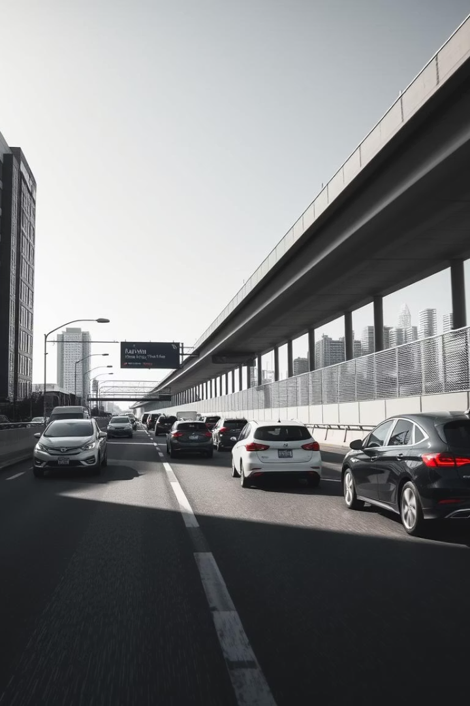
Predicting Traffic Volume using Weather & Time Data
This project uses linear regression to forecast traffic volume.
Combining weather and time data improves prediction accuracy.

Slide 2
Team Members
1. YASH BANSAL (202401100300283)
2. VISHAL SINGH (2024011000300281)
TANMAY KESHARWANI (202401100300261)
TEJASVA PRATAP SINGH TOMAR (202401100300264)

Slide 3
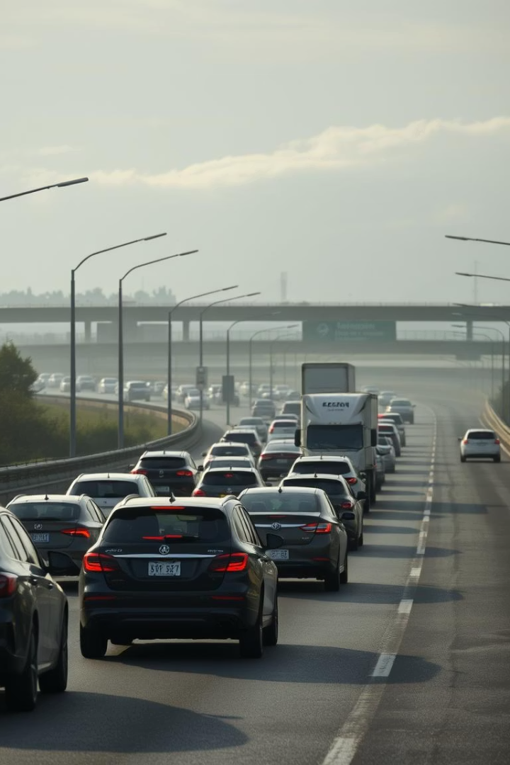
Project Objective
Goal
Predict traffic volume based on weather and time features.
Key Tasks
Feature engineering, visualization, modeling, and evaluation.

Slide 4
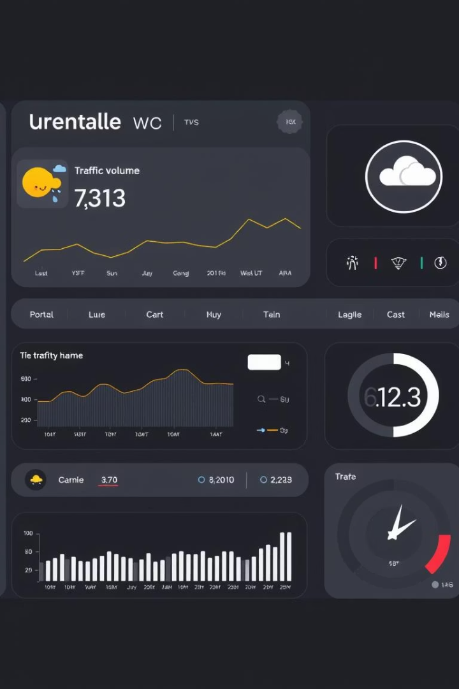
Dataset Overview
Source
Features
Kaggle: Metro Interstate Traffic Volume data
Date & Time
Weather Conditions
Traffic Volume
Holiday Info
Location & Period
Minnesota I-94, 2012-2018 hourly data.

Slide 5
Feature Engineering
Time-Based Features
Categorical Encoding
Hour of Day
Holiday Flags
Day of Week
Weather Conditions
Month
Weekend Indicator

Slide 6




Model Building Process
Preparation
Download, clean, feature engineering, encode.
Scaling & Split
Scale numeric features, split data for training/testing.
Training & Evaluation
Train Linear Regression, evaluate with metrics.

Slide 7
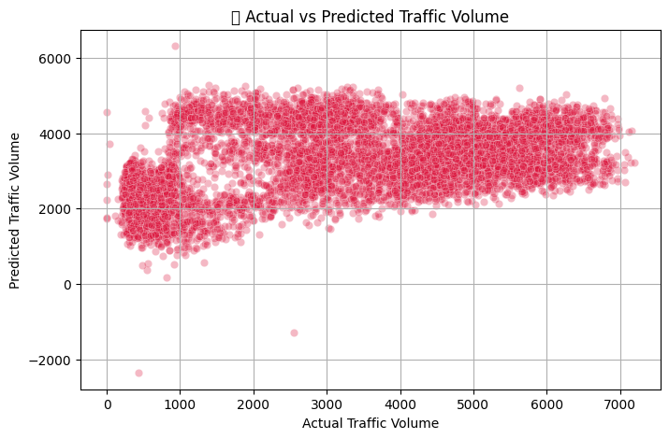
Model Evaluation
4123895.23
Mean Squared Error (MSE)
Measures average squared prediction errors.

Slide 8
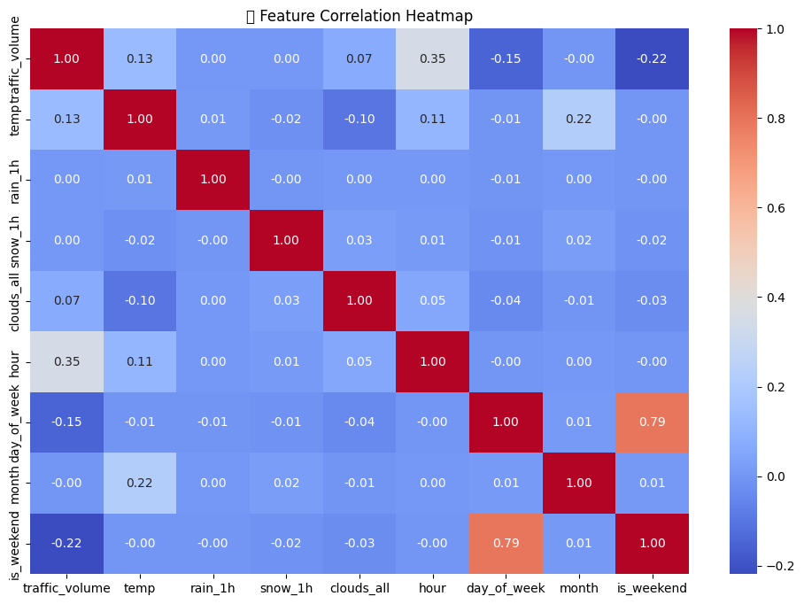
Visualizations
Scatterplot demonstrates prediction accuracy and spread.
Important factors include hour, clouds, rain.
Heatmap highlights strongest traffic influencers.

Slide 9
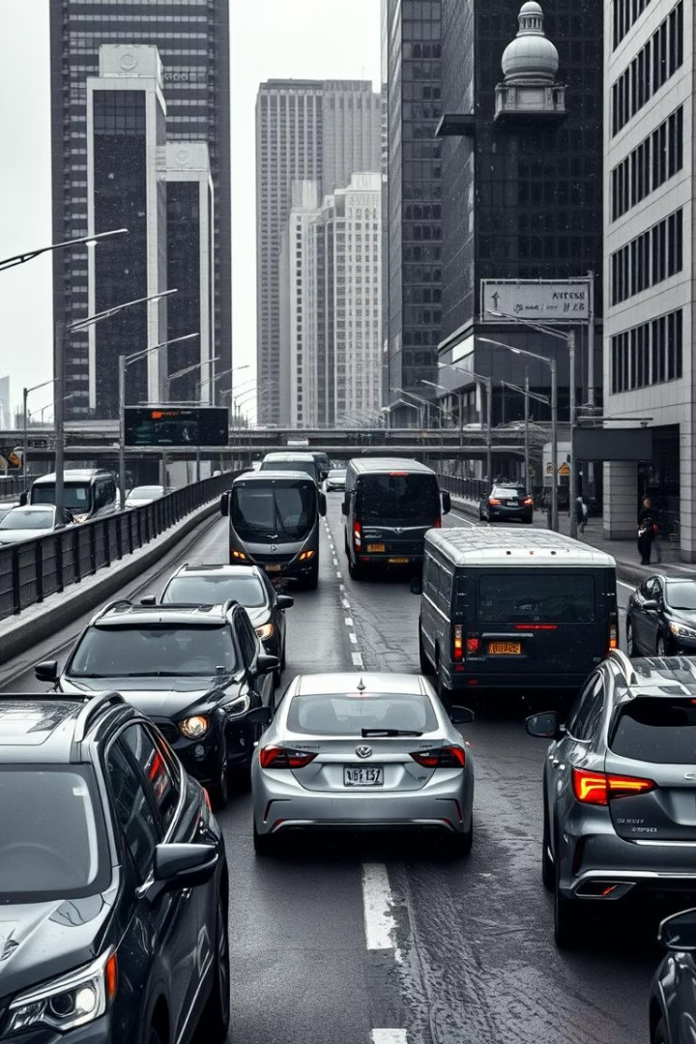
Key Insights
Traffic Influencers
Weekend & Holiday Effect
Hour of day and weather greatly affect volume.
Traffic volume decreases on these days.
Model Use
Linear regression is baseline; advanced models can improve accuracy.

Slide 10
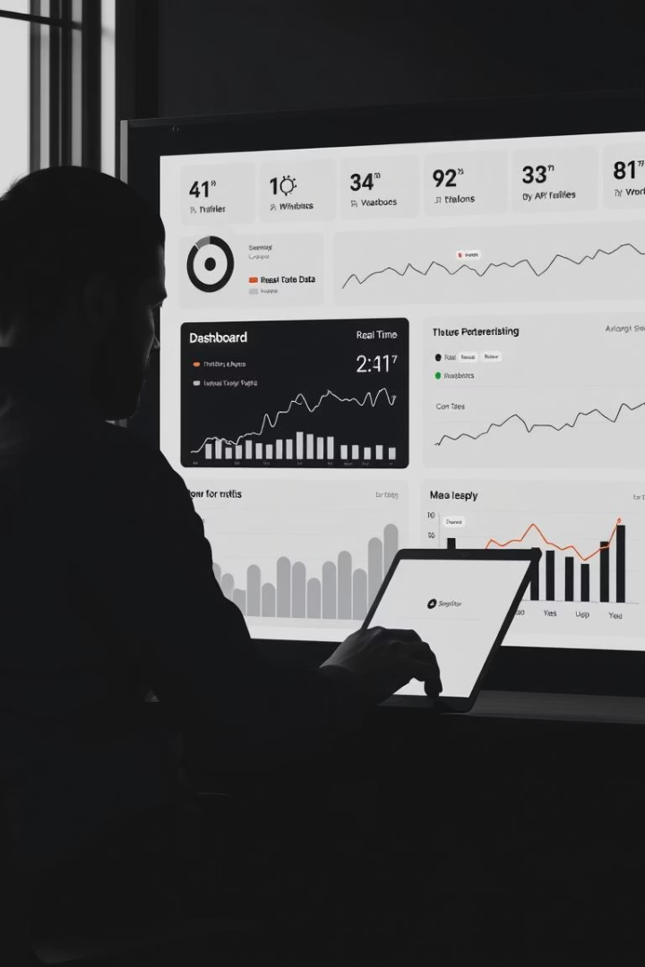
Future Scope
Real-Time Data
Impact Analysis
Integrate live traffic and weather APIs for dynamic prediction.
Analyze how specific events (e.g., concerts, accidents) impact traffic flow.
Predictive Maintenance
Use traffic data to anticipate road wear and inform maintenance schedules.

Slide 11

Conclusion
Weather and time data effectively predict traffic volume.
Feature engineering and preprocessing are key to success.
This lays foundation for more complex modeling and deployment.

Slide 12
References/Credits
· Dataset: Metro Interstate Traffic Volume – Kaggle
· Code Assistance: Implemented using Python, scikit-learn, pandas, and matplotlib
· IDE: Jupyter Notebook / VS Code
· API: KaggleHub for downloading the dataset
· Libraries:
pandas – data handling
sklearn – model training
matplotlib and seaborn – visualization

